Slide 1
NOLB Funding Information Event
NEST Grants Programme 2025-28
2nd September 2024

Slide 2
NOLB Funding Information Event
Agenda
Co-production overview
Co-production analysis
Key themes and priorities
NEST specification
Application process
Timeline
Q&A

Slide 3
CAPITAL CITY PARTNERSHIP – CONTRACTS AND GRANTS OVERVIEW
UK SHARE PROSPERITY FUND (UKSPF) GRANT FUNDING
22 People and Skills projects
14 Communities and Place projects
Six Business Support Projects
Multiply – numeracy support programme
£12m investment over three years
Vocational Training Framework (VTF)
9 sector-specific lots delivered by training providers
Hospitality
Retail
Health & Social Care
Early Learning & Childcare
Construction
Warehouse and Logistics
IT & Creative
Business & Finance
£350k investment for 2023-24
Next Step (Stage 2-4)
Employability offer based across the city, 360 engagements per annum.
£360k investment per annum
All in Edinburgh (Stage 3-5):
Disability and health offer city wide, 425 engagements per annum.
£1.36m investment per annum
JUFJ GRANT FUNDING (NOLB)
16 Network of Employability Support and Training (NEST) projects (Stage 1-5)
£1.2m investment per annum
Seven No One Left Behind (NOLB) Stage 1 projects
£300k investment per annum
JOINED UP FOR FAMILIES (JUFF) GRANT FUNDING
26 Parental Employment Support Fund (PESF) projects (Stage 1-5)
£1.1m investment per annum
Subsidised Childcare (Stage 4-5): four affordable childcare providers city wide targeting 257 families per annum. £913k investment per annum
Encompass - Complex Needs (Stage 1-4): support for clients with a history of issues with drugs/alcohol, criminal justice and homelessness. 240 engagements per annum.
£250k investment per annum
Advance – In-work Support (Stage 5): support for clients in work who are at threat of losing their job or looking to progress. 180 engagements per annum.
£180k investment per annum
Stage 1 provision
Stage 2 provision
Stage 3 provision
Stage 4 provision
Stage 5 provision

Slide 4
NOLB Funding Information Event
Co-production Overview
Data gathering
Client survey and focus groups
Stakeholder focus groups
Service Provider focus groups
This provided insight into:
Client challenges/barriers
Support required
Current employability provision and client experiences
Service preferences

Slide 5
NOLB Funding Information Event
Co-production Analysis
CLIENT CHALLENGES
Lack of skills/ qualifications
41%
Disability/ health condition
35%
Childcare
27%
Immigration/ understanding right to work
16%
Housing/ homelessness
14%
CLIENT CHALLENGES IDENTIFIED BY STAKEHOLDERS
Mental health
Housing
Health conditions
Legal/ citizenship issues
CLIENT SUPPORT NEEDS
Finding jobs/support to apply for jobs
65%
Careers advice
44%
Sector-based training
31%
Accessing volunteering opportunities
29%
In-work support
27%
Money/benefits advice
21%
Support to enter education
18%
Support with English/language classes
9%
CLIENT SUPPORT NEEDS IDENTIFIED BY STAKEHOLDERS
Sector-based training
Focus on areas of deprivation
Childcare/financial support
Career preparation
Confidence building
Ethnic Minority Support
Individual tailored needs of clients
Language support
Integration into existing services
Support for employers as well as clients

Slide 6
NOLB Funding Information Event
Key Themes and Priorities
Key themes:
Services should be person-centred and holistic, meeting a variety of needs.
Though most people want to access services in person an online offer is also useful.
Services should support with gaining skills/qualification/work experience/volunteering, moving into work, support in work and links to other support services.
Services should be inclusive and accessible.
Priorities:
Priority groups linked to LEP Strategy and Tackling Child Poverty.
Delivery of employability support linked to other, holistic support required.
Local links and knowledge

Slide 7
NOLB Funding Information Event
NEST Specification
Grants of up to £100,000 per annum
Inflationary increase of 3% added for year two and three for successful bids
Overall pot of funding to be confirmed
No minimum grant amount
Current average grant for 2024-25 is c.£63,000
Separate application required per project
Grant to be client-focused
Draft applications can be reviewed by CCP – not mandatory to submit a draft

Slide 8
NOLB Funding Information Event
Additional NOLB Programmes
Vocational Training Framework
Moving Forward (NOLB Stage 1)
Council internal programmes:
Edinburgh Employer Recruitment Incentive (EERI)
Edinburgh Guarantee
Project SEARCH (part funding)
Job Creation Scheme
Paid Work Placements
PES Team

Slide 9
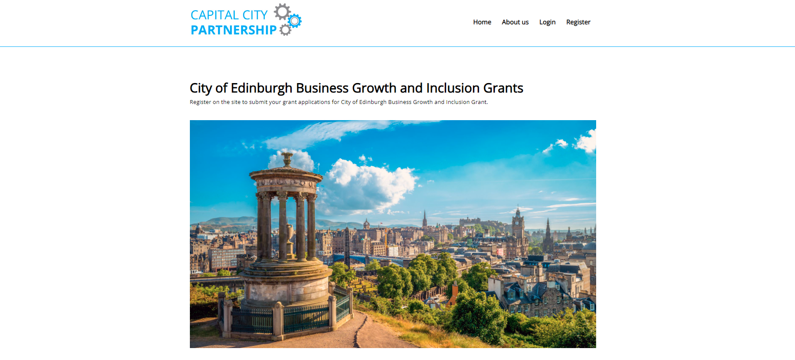
NOLB Funding Information Event
Application Process

Slide 10
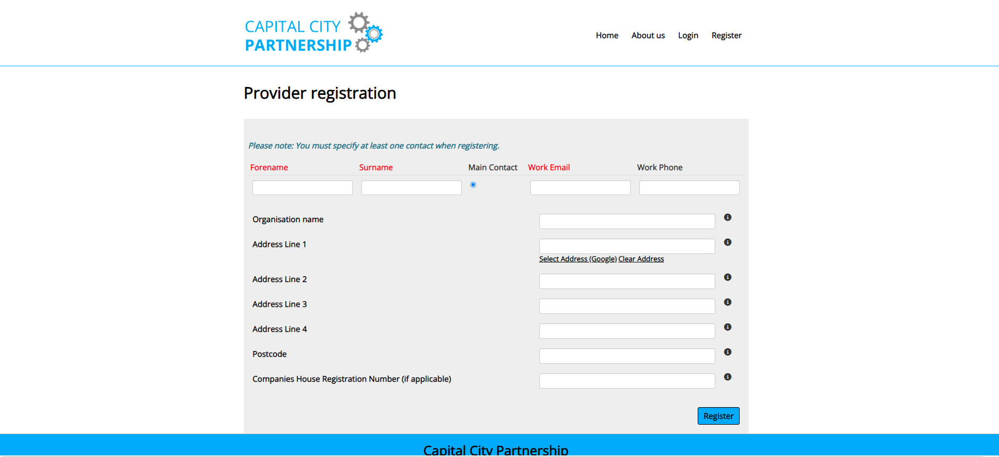
NOLB Funding Information Event
Application Process

Slide 11
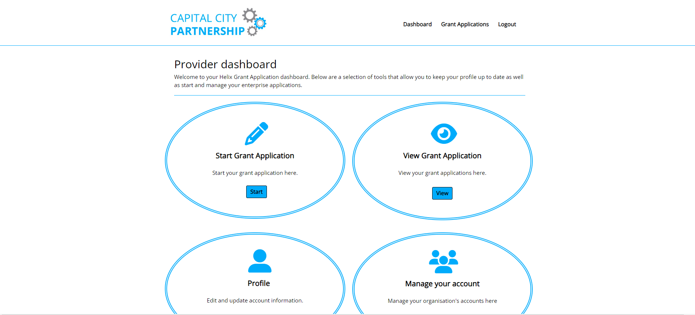
NOLB Funding Information Event
Application Process

Slide 12
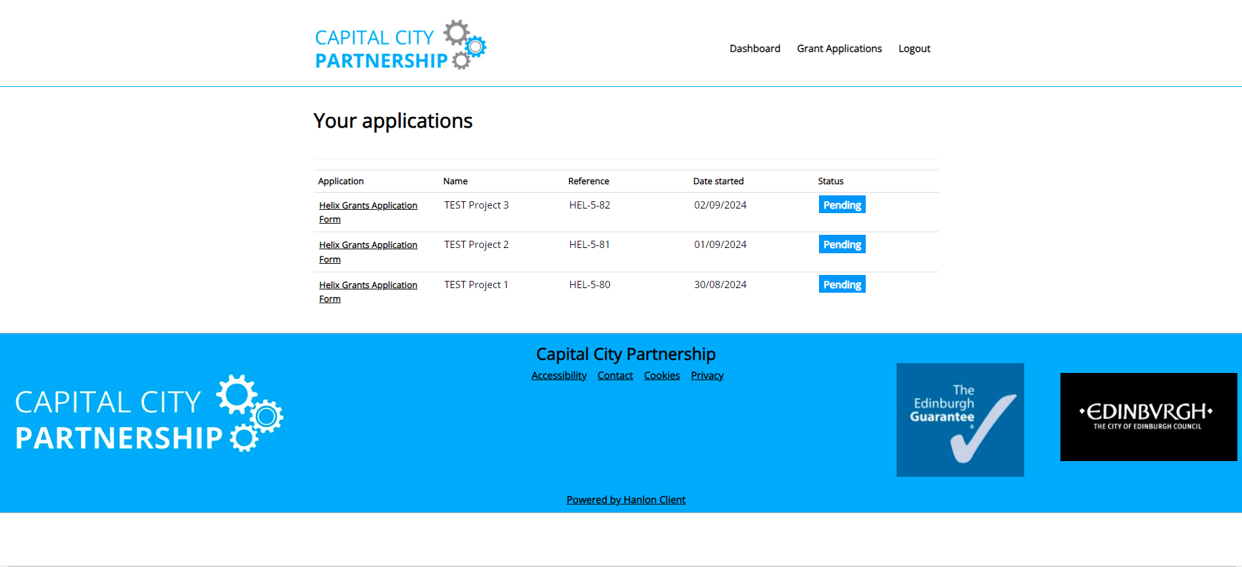
NOLB Funding Information Event
Application Process

Slide 13
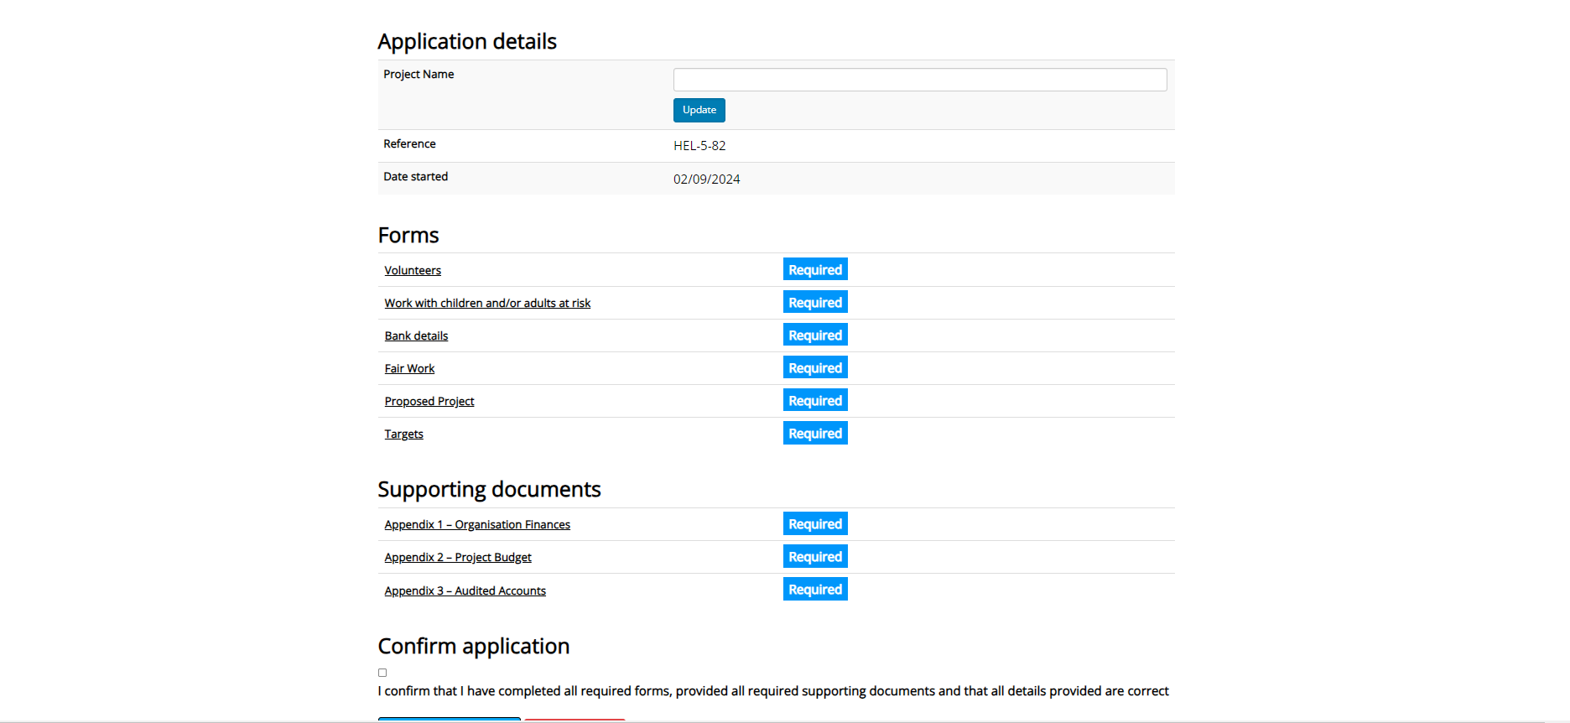
NOLB Funding Information Event
Application Process

Slide 14
NOLB Funding Information Event
Application Process
Start application automatically adds a project to Grant Applications section
Cancel application – deletes unwanted applications
Project name - what will the application and project be called
Three-year grant funding period
Proposed project – new questions 12-16
Targets – number of people over the course of the grant, not annual
Supporting documents – included in application pack
Confirmation message and email

Slide 15
NOLB Funding Information Event
Application Process
Register for the portal asap
Suggest one person registers – who is likely to be submitting application
Use Word document to draft
Review guidance documentation
If possible, get someone to proofread prior to submission
Any problems: contracts@capitalcitypartnership.org

Slide 16
NOLB Funding Information Event
Application Process
Scoring and selection weighted
Proposed Project: question 1, 5 and 6 = maximum of six points
Proposed Project: questions 7-11 = maximum of three points
Targets = maximum of three points
Maximum total score available = 36 points
Bids scoring 17 or less will not be considered for funding

Slide 17
DWP Funding Updates Workshop
Timeline
Committee Approval: August 2024
Data gathering: May/June 2024
Co-production sessions: May-July 2024
Committee Approval: December 2024
Application process: September/October 2024
Application scoring: October/November 2024
All projects launch: April 2025
Funding announcement: December 2024
Transition Period: January-March 2025
Procurement Plan: July 2024

Slide 18
LOI2 Funding Updates
FURTHER INFO
Craig Dutton
Head of Contracts and Grants Capital City Partnership
Foxglove Offices, 14 Links Place, Edinburgh, EH6 7EZ
P: 07960 002 001
E: craig.dutton@capitalcitypartnership.org

